Slide 1



Predicting the occurrence of bluefin tuna (Thunnus thynnus) larvae in the Gulf of Mexico
Barbara Muhling
John Lamkin
Mitchell Roffer
Frank Muller-Karger
Sennai Habtes
Matt Upton
Greg Gawlikowski
Walter Ingram

Slide 2
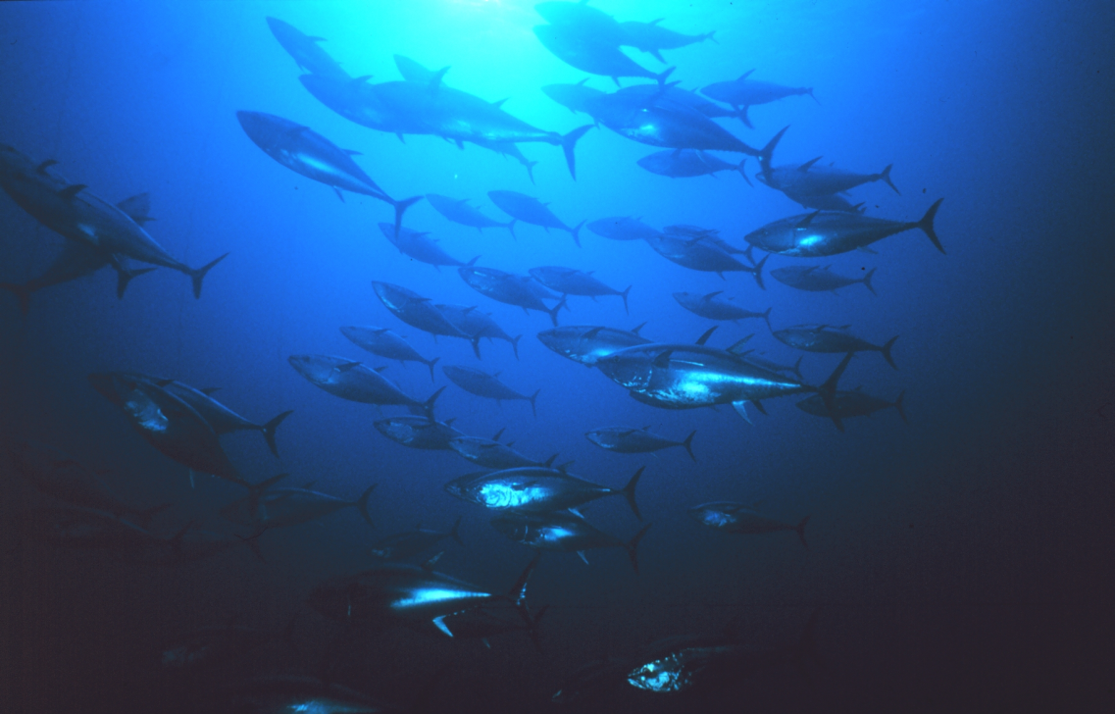
Bluefin tuna biology and life history
Atlantic Bluefin Tuna (Thunnus thynnus) is a large, highly migratory species which ranges throughout the Atlantic ocean
However the vast majority of spawning occurs only in the Gulf of Mexico, and Mediterranean Sea
Exploitation has been historically high, and stocks declined steeply in the 1970s (ICCAT)
Western Atlantic Bluefin Tuna: Median estimates of
spawning biomass and recruitment (ICCAT)

Slide 3
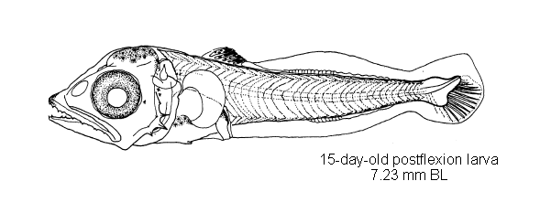
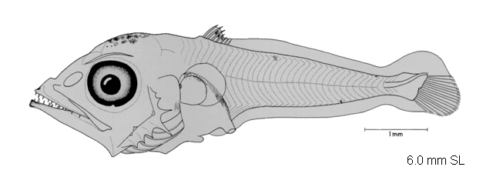
The Bluefin Tuna larval index
The only fishery-independent index currently input into the bluefin tuna stock assessment is the larval abundance index
Variance in this index is currently high, which limits its accuracy
It is hypothesized that some of this variability is due to environmental influences on larvae
However this possibility has not been investigated to date
Larval index using three different models, with coefficient of variation shown (inset) (Ingram et al., 2007)

Slide 4
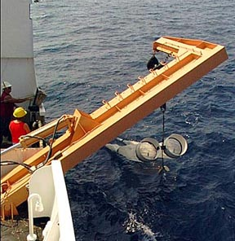
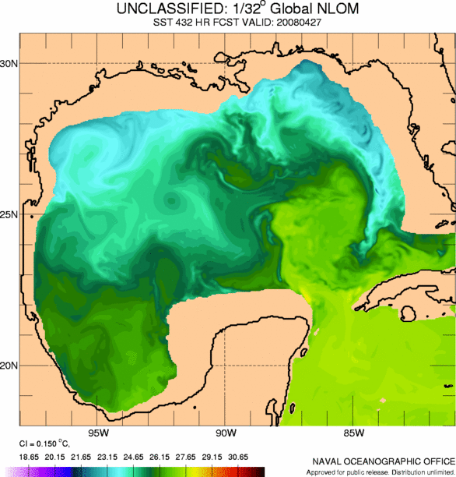
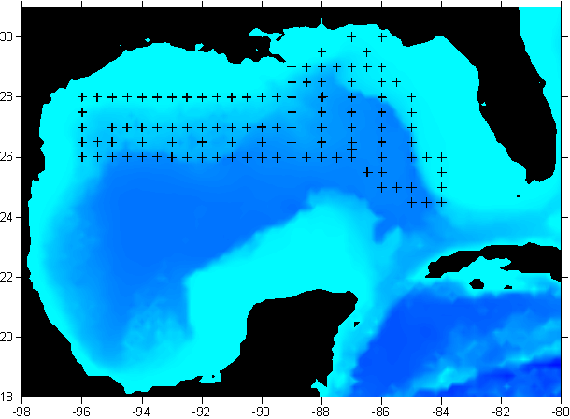
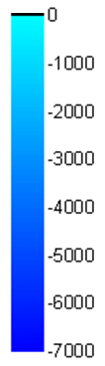
Sampling for bluefin tuna larvae
Annual spring (April – June) plankton surveys targeting bluefin tuna larvae have been completed across the northern Gulf of Mexico since 1977
Sampling methods included bongo net tows, neuston net tows, and CTD casts for environmental data
Loop Current
Depth (m)

Slide 5
Spawning biomass and larval abundance
Bluefin larval abundance and distributions in the Gulf of Mexico have been highly variable spatially and temporally over the past 30 years
1983:
Eastern distribution
2001:
Western distribution
Neuston tow
Bongo tow
Much of this variability can be accounted for by interannual variation in the strength and position of oceanographic features, such as the Loop Current, warm Loop Current eddies and low salinity river plumes
A simple modeling approach was used to identify oceanographic habitats of low, and high, favorability for the collection of bluefin tuna larvae

Slide 6
Larval occurrences and environmental variables
In-situ environmental variables were available from CTD casts, and plankton samples
Temperature and salinity data at the surface, 100m depth and 200m depth were available, as well as longitude, latitude and water depth, and total settled plankton volume from bongo net samples
Conditions which were more favorable for the occurrence of bluefin tuna larvae were examined, using data from across the 25 year survey period
Example: Sea surface temperature
Frequency distribution of temperatures where larvae have been found
2) Frequency distribution of temperatures from all sampled stations
3) Probability of collecting bluefin larvae from within each temperature range

Slide 7
Classification tree modeling
A simple, intuitive and non-parametric method to define conditions where larvae are most likely to be found
Completed using DTREG software
Both continuous and categorical variables can be used
Ability to set misclassification cost
To make the model as applicable as possible, 10% of the dataset was randomly withheld for out-of-model validation

Slide 8
Classification tree modeling
Algorithms sequentially split the dataset into two groups using environmental variables
Each split attempts to separate conditions which are favorable, and unfavorable, for larval bluefin tuna occurrence
Each station sampled can be classified into one of the terminal nodes, which gives a probability of larval occurrence
Classification tree model of favorable larval bluefin tuna habitat
All samples
N = 998
T200m < 21.0
N =902
Positive Stn
T200m > 21.0
N =96
Negative Stn
Date < 8th May
N =375
Negative Stn
Date > 8th May
N =527
Positive Stn
SSS < 36.42
N = 244
Negative Stn
SSS > 36.42
N = 131
Positive Stn
Moon Phase < 0.51
N = 291
Positive Stn
Moon Phase > 0.51
N = 236
Positive Stn
Moon < 0.26
N = 71
Positive Stn
Moon > 0.26
N = 173
Negative Stn
SST < 23.37
N = 23
Negative Stn
SST > 23.37
N = 108
Positive Stn
SST < 28.5
N = 276
Positive Stn
SST > 28.5
N = 15
Negative Stn
Plankton (log) < 1.64
N = 84
Negative Stn
Plankton (log) > 1.64
N = 152
Positive Stn
Longitude > 87.8
N = 70
Positive Stn
Longitude < 87.8
N = 82
Negative Stn
Longitude < 87.0
N = 49
Positive Stn
Longitude > 87.0
N = 22
Negative Stn
Bluefin larvae were most likely to be found:
- Where temperatures at 200m were lower
- After May 8th each year
- During darker moon phases
- Where sea surface temperatures were between ~ 23.4 and 28.5°C
SST < 25.6
N = 24
Positive Stn
SST > 25.6
N = 58
Negative Stn
(Muhling et al., submitted)

Slide 9
Habitat modeling results
Bluefin tuna larvae were assigned to favorable habitat with ~88% accuracy
Changes in larval distribution largely explained by changed in habitat extent

Slide 10
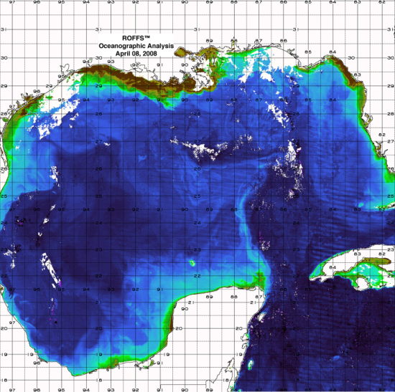
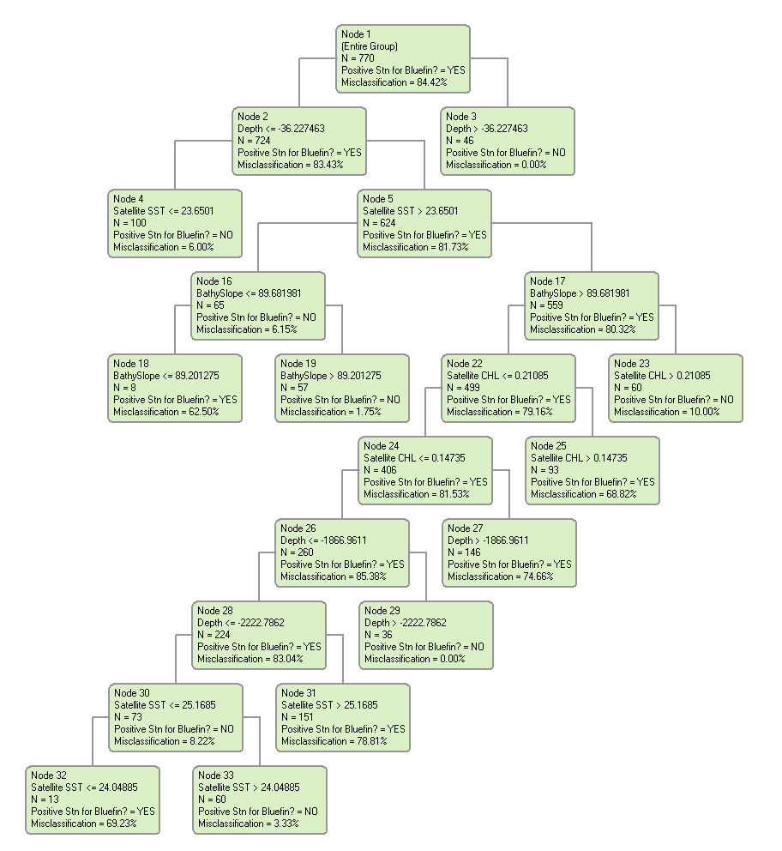
Modeling using remotely sensed data
The current also relies on in-situ data, and therefore cannot make real-time predictions
To address this, we need to build a model that uses remotely sensed data
By extracting remotely sea surface temperature, and chlorophyll, data from each sampled station for past cruises, we can re-run the classification model using only satellite-derived data
Satellite data extracted for sampled station locations
New classification tree model built using only remotely sensed data

Slide 11
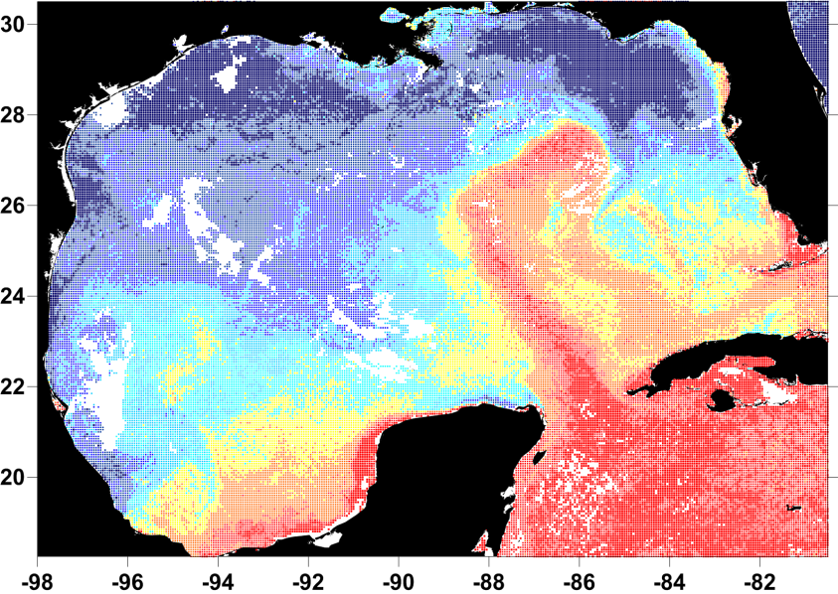
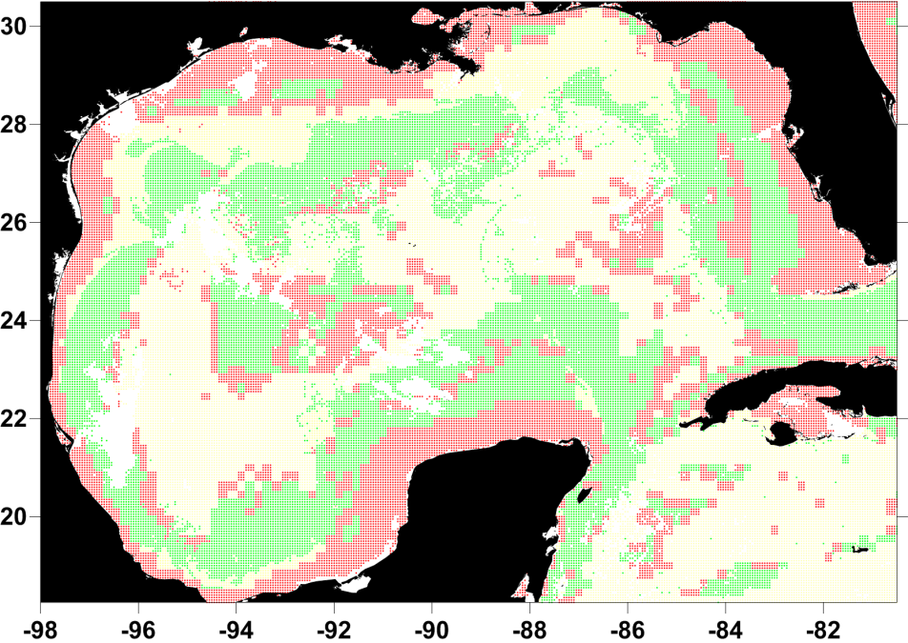
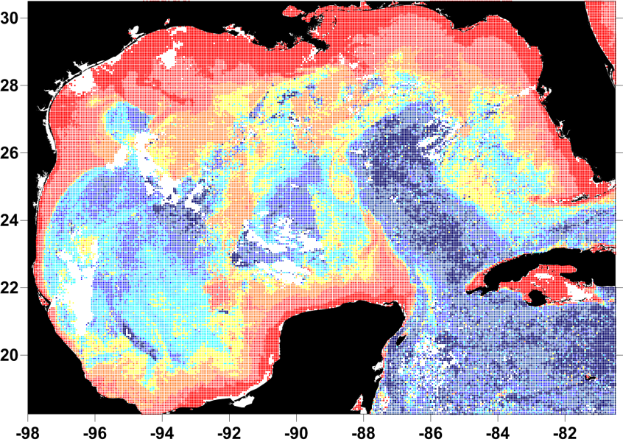
Modeling using remotely sensed data
Using the model derived from satellite data, we can then predict where larval bluefin tuna are most likely to be collected
Once sampling is complete, the accuracy of the model can be tested and validated
Sea surface temperature
Spatial prediction of larval bluefin tuna distributions
Ocean color

Slide 12
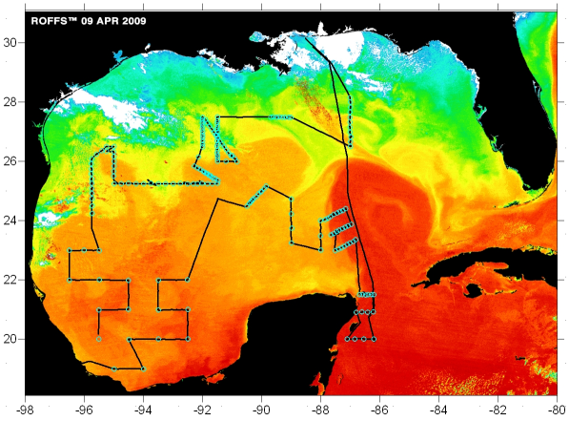
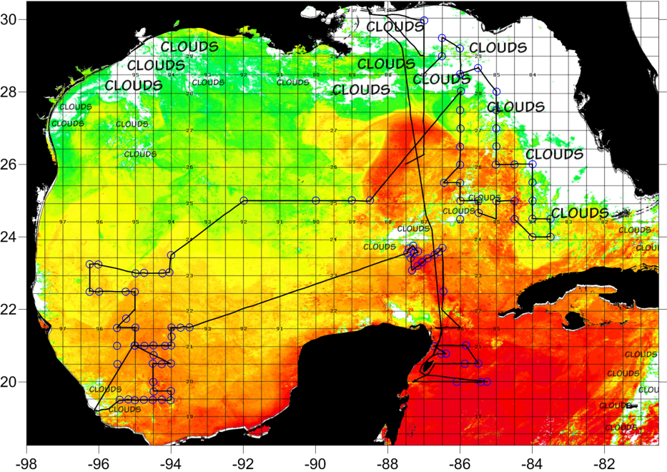
Directed sampling techniques
The current model is also hampered by the coarse spatial resolution of the input data
Bluefin tuna larvae are highly likely to be influenced by smaller scale features such as ocean fronts, convergence zones and frontal eddies
Since 2008, we have been allotted extra time on the spring sampling to cruise, to sample around oceanographic features of interest
These features are identified and targeted using daily satellite imagery
Cruise track and sampling stations: Bluefin tuna cruise 2009
Cruise track and sampling stations: Bluefin tuna cruise 2010

Slide 13
Conclusions
  Larval bluefin tuna distributions in the Gulf of Mexico are influenced by environmental conditions: most notably Loop Current position, and temperature of water on the continental shelf
  Satellite observations show potential as predictors of larval bluefin tuna habitat, and work on a predictive model is ongoing
  Our habitat model/s can be integrated into the existing larval index, and if it lowers the coefficient of variation, will ultimately improve the adult stock assessment

Slide 14
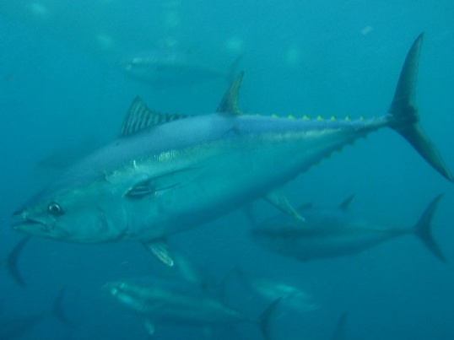
Acknowledgements
NOAA/NMFS
  South East Fisheries Science Centre
    Early Life History Group
    Stock Assessment Division
    Many individuals too numerous to mention!
  Pascagoula Laboratory
    Kim Williams
    Joanne Lyczkowski-Shultz
    David Hanisko
    Denice Drass
    Walter Ingram
Rosentiel School of Marine and Atmospheric Science
  Andrew Bakun
Fisheries and the Environment (FATE)
University of South Florida
  Frank Muller-Karger
  Sennai Habtes
ROFFS Ocean Fishing Forecasting Service
    Greg Gawlikowsi
    Matt Upton
The University of Southern Mississippi
  Jim Franks
  Bruce Comyns
NASA - Biodiversity and Ecological Forecasting
National Research Council (NRC)
Plankton Sorting and Identification Center, Szczecin, Poland
Img: V. Ticina

